Slide 1
Error Metrics

Slide 2
Learning Goals
In this section, we will cover:
- Types of errors made in Classification problems
- Approaches to measuring Classification outcomes
- Using Classification error metrics to choose between models

Slide 3
Choosing the Right Error Measurement
You are asked to build a classifier to predict whether individuals have leukemia.
Training data:
- 1% patients have leukemia, 99% are healthy.
Measure accuracy:
- total % of predictions that are correct.
Build a simple model that always predicts "healthy".
Accuracy will be ... 99%.

Slide 4
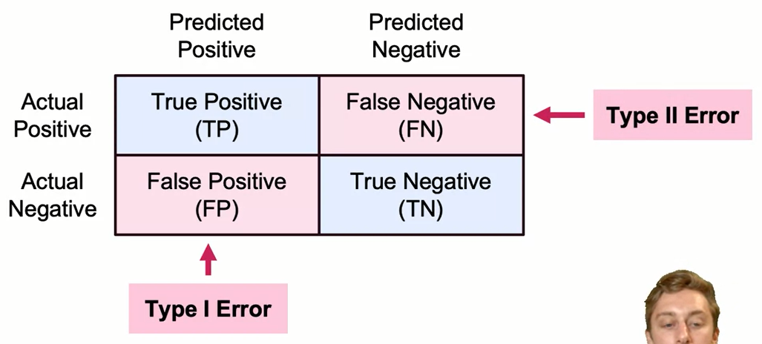
Confusion Matrix

Slide 5
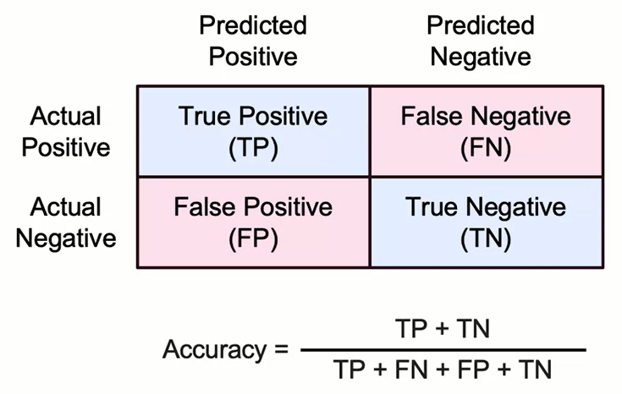
Accuracy: Predicting Correctly

Slide 6
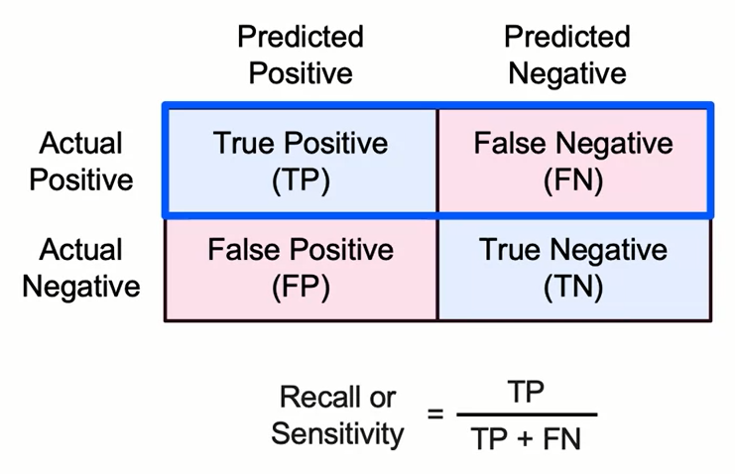
Recall: Identifying All Positive Instances

Slide 7
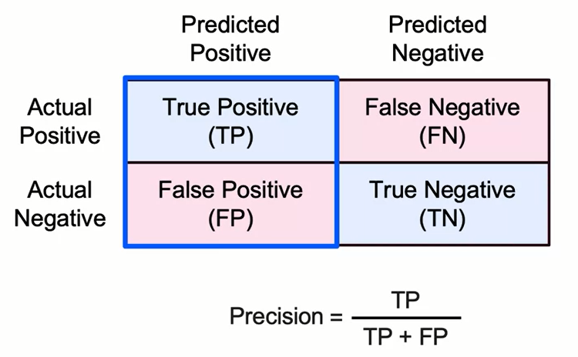
Precision: Identifying Only Positive Instances

Slide 8
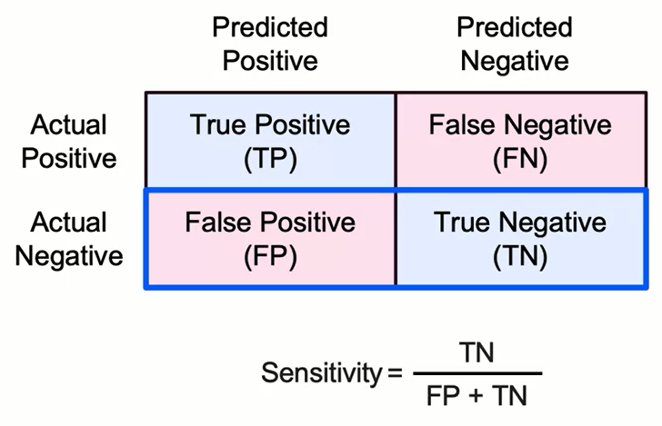
Specificity: Avoiding False Alarms

Slide 9
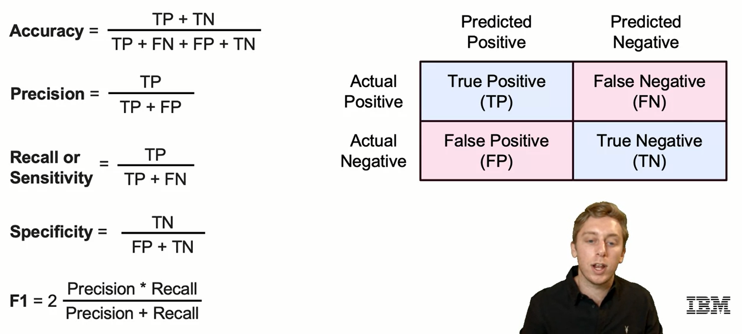
Error Measurements

Slide 10
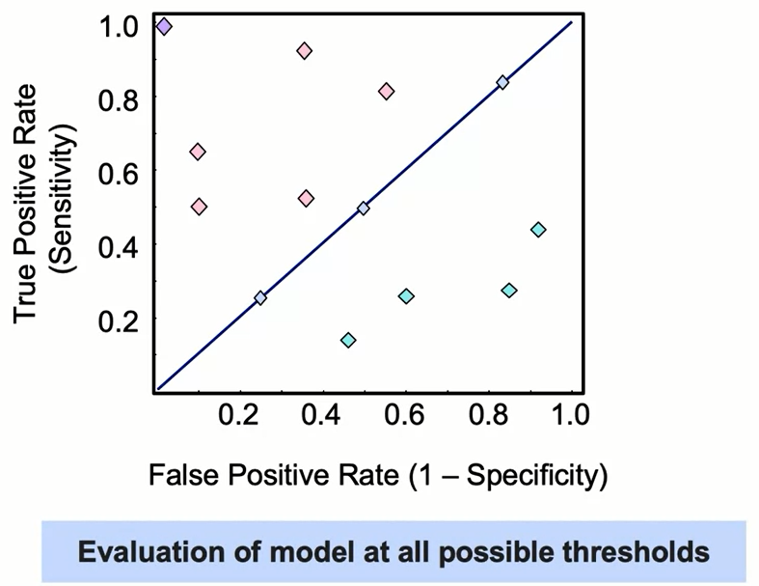
Receiver Operating Characteristic (ROC)

Slide 11
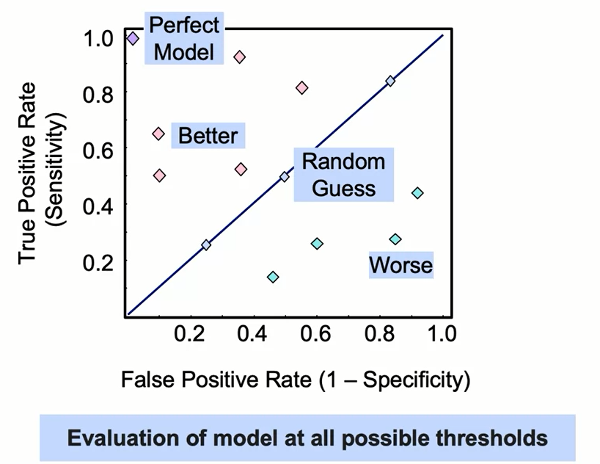
Receiver Operating Characteristic (ROC)

Slide 12
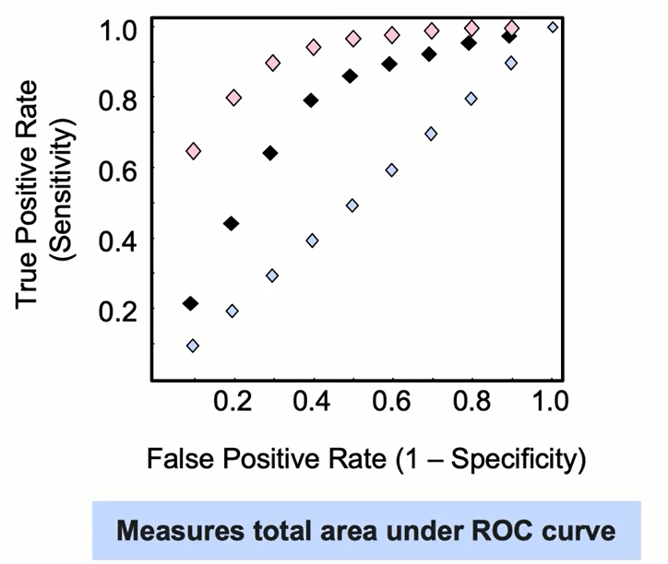
Receiver Operating Characteristic (ROC)

Slide 13
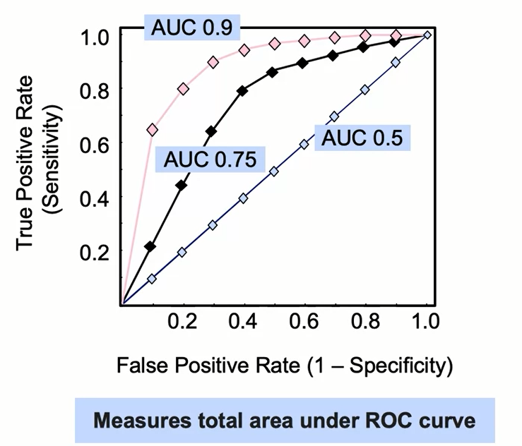
Receiver Operating Characteristic (ROC)

Slide 14
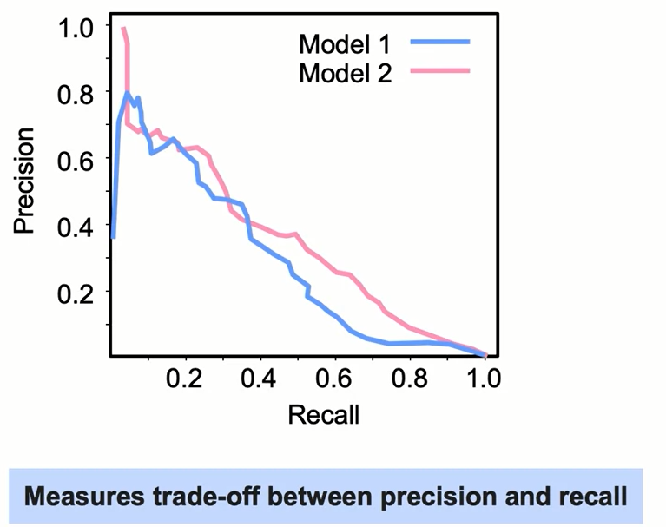
Precision-Recall Curve

Slide 15
Choosing the Right Approach
Which approach works best for choosing a classifier?
ROC Curve:
- Generally better for data with balanced classes.
Precision-Recall Curve:
- Generally better for data with imbalanced classes.
The right curve depends on tying results (true positives, true negatives, etc.) to outcomes (relative cost of false positive or false negative).
The curves compare classifiers generally (across possible decision thresholds), which may be less relevant to business objectives.

Slide 16
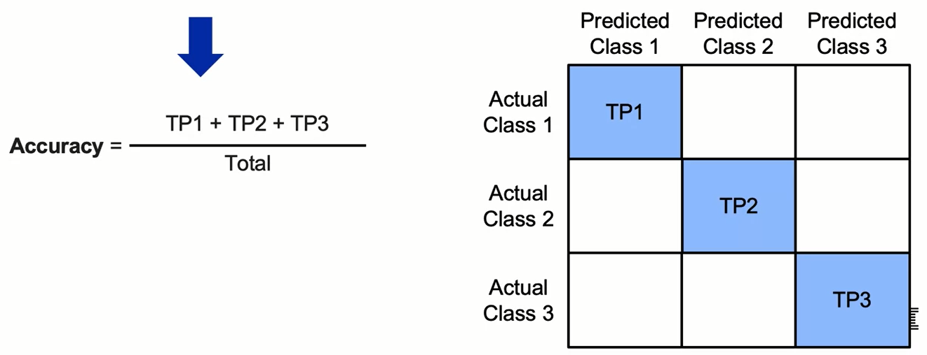
Multiple Class Error Metrics
Most multi-class error metrics are similar to binary versions, they just expand elements as a sum.

Slide 17
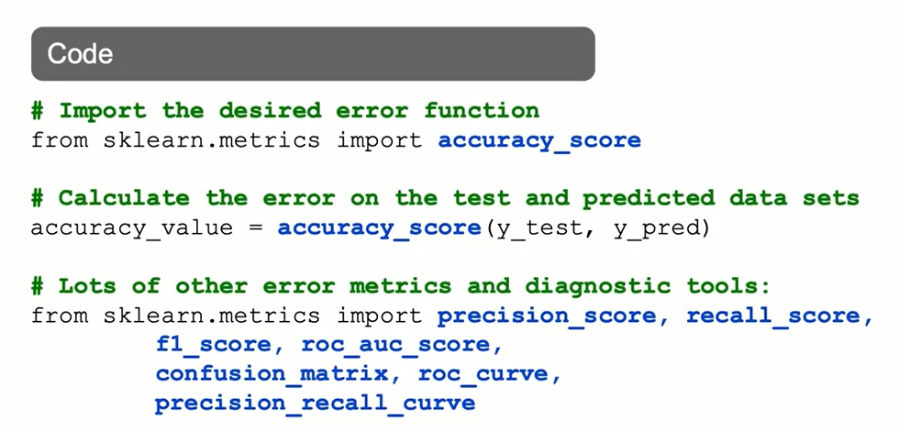
Classification Error Metrics: The Syntax

Slide 18
Summary
Classification Error Metrics
A confusion matrix tabulates true positives, false negatives, false positives and true negatives. Remember that the false positive rate is also known as a type I error. The false negatives are also known as a type II error.
Accuracy is defined as the ratio of true postives and true negatives divided by the total number of observations. It is a measure related to predicting correctly positive and negative instances.
Recall or sensitivity identifies the ratio of true positives divided by the total number of actual positives. It quantifies the percentage of positive instances correctly identified.
Precision is the ratio of true positive divided by total of predicted positives. The closer this value is to 1.0, the better job this model does at identifying only positive instances

Slide 19
Summary
Classification Error Metrics
Specificity is the ratio of true negatives divided by the total number of actual negatives. The closer this value is to 1.0, the better job this model does at avoiding false alarms.
The receiver operating characteristic (ROC) plots the true positive rate (sensitivity) of a model vs. its false positive rate (1-sensitivity).
The area under the curve of a ROC plot is a very common method of selecting a classification methods.
The precision-recall curve measures the trade-off between precision and recall.
The ROC curve generally works better for data with balanced classes, while the precision-recall curve generally works better for data with unbalanced classes.

Slide 20
Learning Recap
In this section, we discussed:
- Types of errors a made in Classification problems
- Approaches to measuring Classification outcomes
- Using Classification error metrics to choose between models

